Slide 1
A Generic Approach to Automatic Deobfuscation of Executable Code
Paper by Babak Yadegari, Brian Johannesmeyer, Benjamin Whitely, Saumya Debray
Notes:
Sources:

Slide 2
Background: Obfuscation
In general: obscuring semantics of a message
In code, hides nature of implementation
Malicious software uses it to:
avoid detection
prevent reverse engineering
make analysis difficult

Slide 3
Background: Obfuscation
Variety of approaches to obfuscating code
Can combine approaches to create layers of complexity
Commercially available obfuscation tools
Approaches mentioned in the paper:
Emulation-based obfuscation
Return-oriented programming

Slide 4
Background: Emulation-Based
Design a VM with an arbitrary instruction set i
Translate executable into this byte-code of i
Program interpreted by emulator for the VM
Instruction set can be perturbed for each instance of program
Can be combined with run-time unpacking
This obfuscation creates a problem because:
Execution trace only shows instructions in the emulator
Confusing memory accesses: some for program logic, some for emulator

Slide 5
Background: Return-oriented
Intended to bypass DEP
Gadgets: code snippets ending in return statement
Strung together via a buffer containing their addresses
Scattered code
JIT generation can add to confusion
Non-deterministic functionality from run to run

Slide 6
Research Problem (in general)
One of the primary ways to understand and defend against malicious software is via reverse engineering real pieces of code
Figuring out how to deobfuscate obfuscated software is thus an important problem in security

Slide 7
Related Solutions and Limitations
Coogan et al (reference 6): use equational reasoning to simplify emulation based execution traces
Sharif et al (reference 5): start by reverse engineering the VM, then recover logic from byte code
Lu et al (reference 9): translate ROP shellcode to non-ROP shellcode
Coogan’s solution struggles with complex control flow
Sharif’s solution has to make strong assumptions about the emulator
Lu’s solution is specific to ROP

Slide 8
Motivation and Research Problem v2
The drawback mentioned for Lu’s solution is shared by the others
This is the limitation that motivated the authors
Current deobfuscation techniques have to make an assumption about the obfuscation technique
Can’t handle instances of new or alternative techniques
The actual research problem addressed in the paper: How can we design a general approach to deobfuscation that works regardless of the obfuscation technique?

Slide 9
Contribution
The authors successfully describe and design a generic approach to deobfuscation
Implement their approach and evaluate it
Test programs obfuscated by emulation-based and return oriented programming, programs obfuscated via commercial tools

Slide 10
Approach
Note about threat model: assumes attacker is aware of their approach
First step to deobfuscation is determining what is semantically significant
Issue: this changes based on obfuscation technique
How to decide what is significant without making assumptions?

Slide 11
Approach
Solution: consider mapping of input values to output values
How does the input affect the output?
Use dynamic analysis
Collect multiple execution traces
Use info to simplify code and develop CFG

Slide 12
Approach
Four main steps
Identifying input and output values
Taint propagation and analysis
Code simplification
Control flow graph construction

Slide 13
Approach

Slide 14
Identifying Input to Output Flows
Steps 1 and 2 from previous slide
Step 1: Determining input and output values
Input values
values obtained from command line (arguments)
values written by a library routine, read by program instruction
Output values
defined by program instruction, read by library routine

Slide 15
Identifying Input to Output Flows
Step 2
Taint analysis/taint propagation
This is what actually determines the flow of input to output
i.e. how the input values eventually determine the output values
Notion of “tainted” values
Initial tainted values: input values
Values computed from tainted values become tainted
Forward and backward analysis
Special implementation

Slide 16
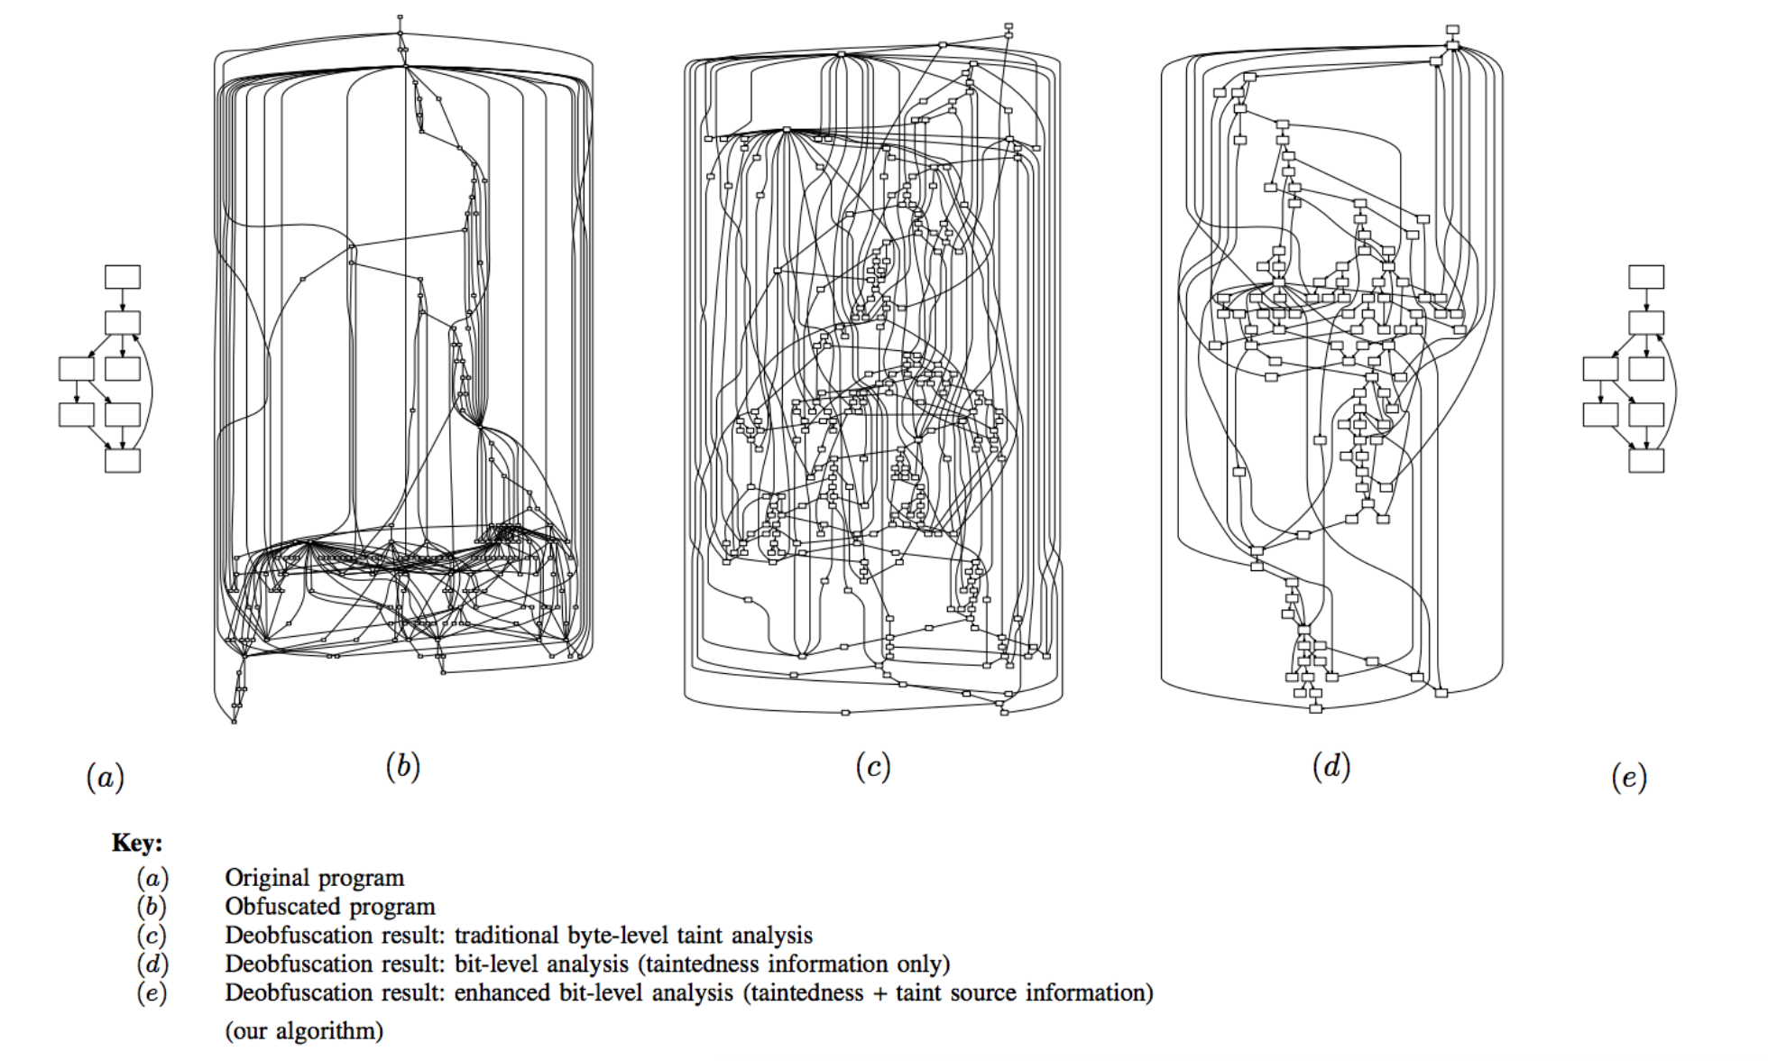
Identifying Input to Output Flows

Slide 17
Approach

Slide 18
Control Dependency Analysis
Necessary for the final steps
Notion of control-dependent instructions
Instruction j control-dependent on i if:
outcome of i determines if j is executed
Why is it necessary?
Get explicit control flow almost straight from taint analysis, but not implicit
Knowing both is important for untangling CFG

Slide 19
Approach

Slide 20
Trace Simplification
Step 3
This is where the code gets simplified
Use semantics preserving transformations
Notion of quasi-invariant locations
They mention the following transformations (non-exhaustive)
Arithmetic simplification
Indirect memory reference simplification
Data movement simplification
Dead code elimination
Control transfer simplification

Slide 21
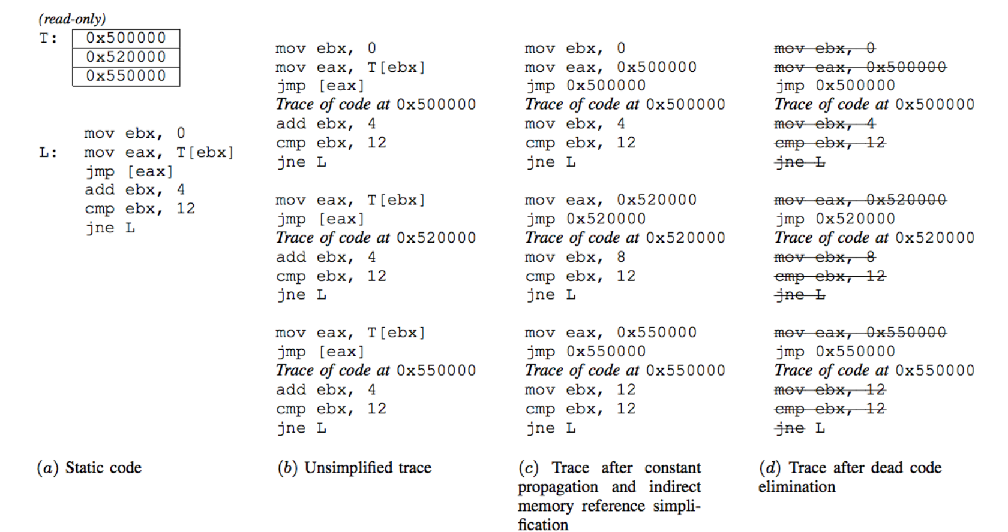
Trace Simplification

Slide 22
Approach

Slide 23
Control Flow Graph Construction
Final step
Use the simplified trace T from the previous step
sequence of instructions -> sequence of basic blocks
Follow their given algorithm to add edges to graph G connecting blocks
Difficulties to handle
Code reuse causes lots of tangled connections
Not violating graph structural constraints
Dead code elimination causes algorithm to create unnecessary blocks

Slide 24
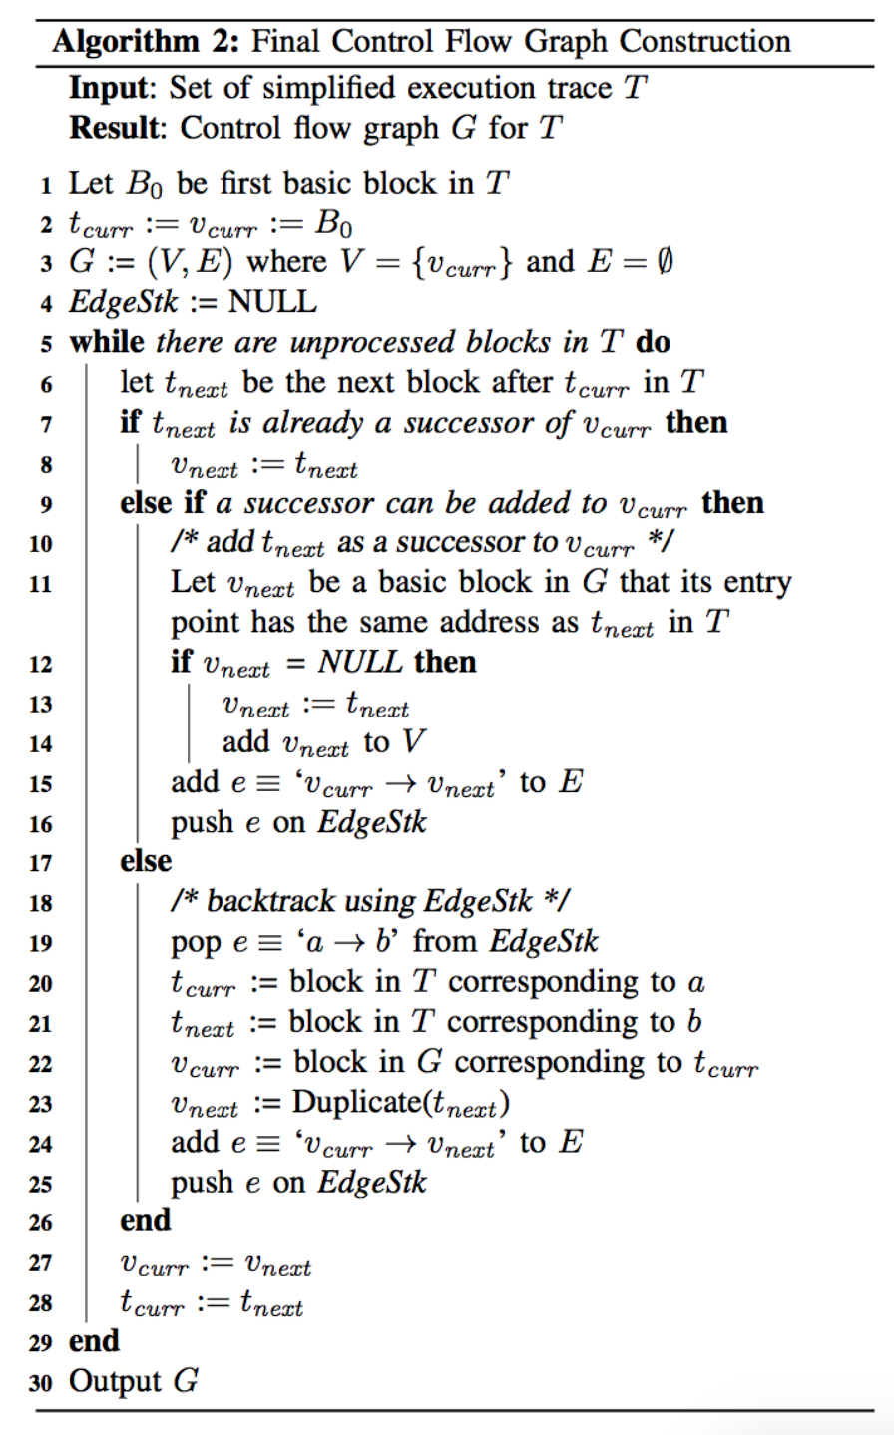
Control Flow Graph Construction

Slide 25
Evaluation
Prototype implementation
Evaluate by using edit distance algorithm to compare CFG’s
Emulation-based
Try to deobfuscate code obfuscated by four commercial tools
Single and multi-level emulation
Average similarity %84.55 for single, %83.85 for multi
Return oriented
2 sets of test programs
Simple synthetic programs, ie. factorial, bubble-sort
Average similarity %84.16
Compared results with results from Coogan’s tool
30 to 60 percent higher similarity

Slide 26
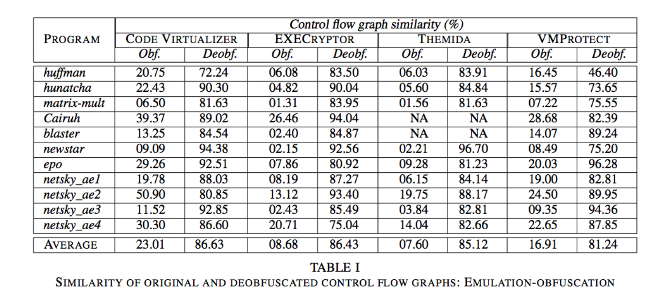
Evaluation

Slide 27
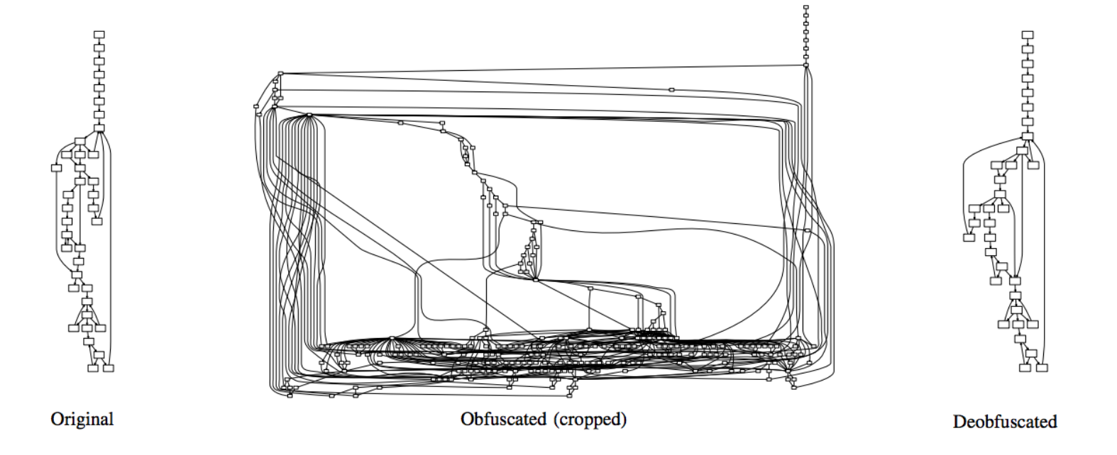
Evaluation

Slide 28
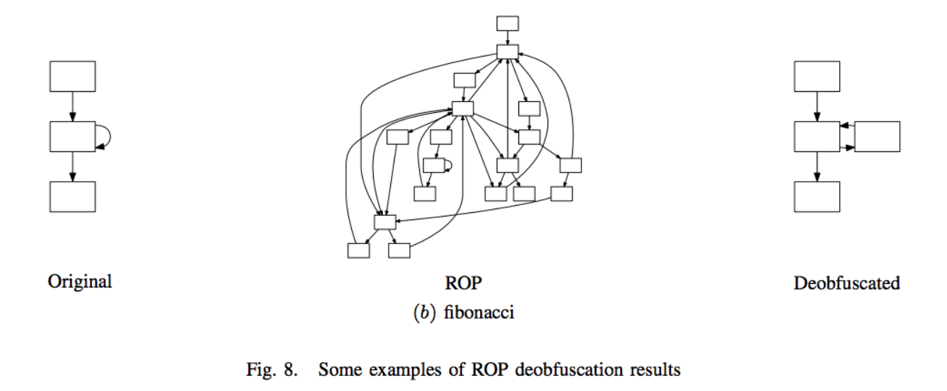
Evaluation

Slide 29
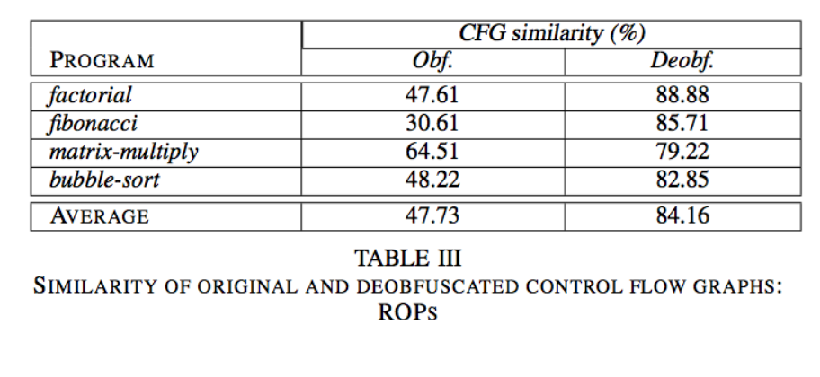
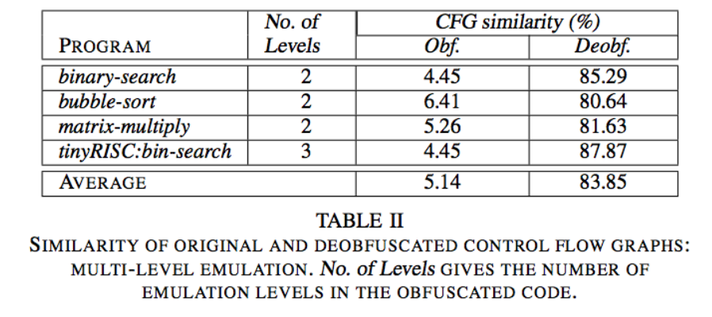
Evaluation

Slide 30
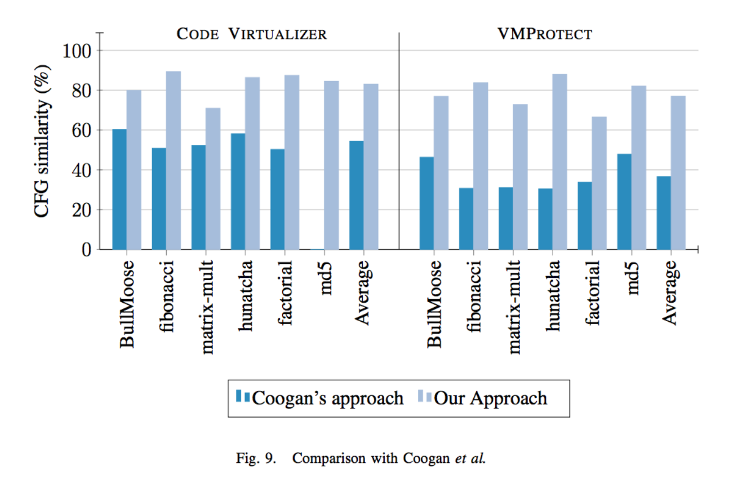
Evaluation

Slide 31
Author Mentioned Limitations
Doesn’t handle a program attempting to thwart analysis
Code coverage could be an issue
Given assumption about attacker, three ways one could attempt to weaken effectiveness
don’t obfuscate i/o, but entwine obfuscated code with i/o more deeply
add in noisy i/o operations
hide some computations

Slide 32
My Criticisms/Opinion
Overall, I thought the paper was good
For a complicated topic, was less of a struggle than I expected
Some reasonings/explanations felt forced though
For example, quasi-invariant locations
How steps of approach link together
Claim generic approach, but test only two obfuscation techniques
Zero to limited discussion of how CFG dissimilarity would affect potential understanding of program
What’s an acceptable threshold?
IE is a %70 similar CFG really helpful?

Slide 33
Questions
What two obfuscation techniques do the authors focus on?
For taint propagation, what initial values are “tainted” and how do tainted values spread?
What was the primary limitation of existing solutions that motivated this paper?

Slide 34
Questions
What two obfuscation techniques do the authors focus on? Emulation-based and Return-Oriented Programming
For taint propagation, what initial values are “tainted” and how do tainted values spread?
What was the primary limitation of existing solutions that motivated this paper?

Slide 35
Questions
What two obfuscation techniques do the authors focus on? Emulation-based and Return-Oriented Programming
For taint propagation, what initial values are “tainted” and how do tainted values spread? I.E. Input values: from command line, written from library rountine Any computations involving a tainted value becomes tainted
What was the primary limitation of existing solutions that motivated this paper?

Slide 36
Questions
What two obfuscation techniques do the authors focus on?
For taint propagation, what initial values are “tainted” and how do tainted values spread?
What was the primary limitation of existing solutions that motivated this paper?

Slide 37
Thank you!

